Slide 1

Data Service Specification:
RDF(S) Ontology Access
Access Services for RDF Data Resources

Slide 2

OGF IPR Policies Apply
“I acknowledge that participation in this meeting is subject to the OGF Intellectual Property Policy.”
Intellectual Property Notices Note Well: All statements related to the activities of the OGF and addressed to the OGF are subject to all provisions of Appendix B of GFD-C.1, which grants to the OGF and its participants certain licenses and rights in such statements. Such statements include verbal statements in OGF meetings, as well as written and electronic communications made at any time or place, which are addressed to:
    the OGF plenary session,
    any OGF working group or portion thereof,
    the OGF Board of Directors, the GFSG, or any member thereof on behalf of the OGF,
    the ADCOM, or any member thereof on behalf of the ADCOM,
    any OGF mailing list, including any group list, or any other list functioning under OGF auspices,
    the OGF Editor or the document authoring and review process
Statements made outside of a OGF meeting, mailing list or other function, that are clearly not intended to be input to an OGF activity, group or function, are not subject to these provisions.
Excerpt from Appendix B of GFD-C.1: ”Where the OGF knows of rights, or claimed rights, the OGF secretariat shall attempt to obtain from the claimant of such rights, a written assurance that upon approval by the GFSG of the relevant OGF document(s), any party will be able to obtain the right to implement, use and distribute the technology or works when implementing, using or distributing technology based upon the specific specification(s) under openly specified, reasonable, non-discriminatory terms. The working group or research group proposing the use of the technology with respect to which the proprietary rights are claimed may assist the OGF secretariat in this effort. The results of this procedure shall not affect advancement of document, except that the GFSG may defer approval where a delay may facilitate the obtaining of such assurances. The results will, however, be recorded by the OGF Secretariat, and made available. The GFSG may also direct that a summary of the results be included in any GFD published containing the specification.”
OGF Intellectual Property Policies are adapted from the IETF Intellectual Property Policies that support the Internet Standards Process.
Notes:
IPR Notices Note Well for OGF meetings

Slide 3
Full Copyright Notice
Copyright (C) Open Grid Forum (2006). All Rights Reserved.
This document and translations of it may be copied and furnished to others, and derivative works that comment on or otherwise explain it or assist in its implementation may be prepared, copied, published and distributed, in whole or in part, without restriction of any kind, provided that the above copyright notice and this paragraph are included on all such copies and derivative works.
The limited permissions granted above are perpetual and will not be revoked by the OGF or its successors or assignees.
Notes:
OGF Full Copyright Notice if necessary

Slide 4
Outline
Introduction
RDF(S) data model overview
Operational model
Interface organization
Interface specification
Summary
Future work
Notes:
This is the outline of the presentation. Firstly I will introduce our “vision” about the RDF(S) access intitiative, in short, what we want to achieve and how does it fit inside the WS-DAI view. I will also review what RDF(S) is, so everybody who is not familiar with it, will have something to start with and understand our work.
After that I will present the RDF(S) data model as it is of main concern for the ontology access.
I will continue pointing out some issues about the operational model of the ontology access interfaces designed.
How the interfaces are organized and the concrete specification will be explained later.
I will conclude with a short summary and the future work.

Slide 5
Introduction (I)
The RDF(S) Access Vision
What is all about?
  Providing an access mechanism to RDF(S) data sources
Two different means for interacting:
  Query access: using SPARQL
  Ontology access: using ontological primitives based on the RDF(S) model
Alternative, but not exclusive!
  Use each one according to your needs…
Notes:
The RDF(S) access initiative is about providing an access mechanism to data defined by mean of RDF.
The objective is to develop a set of services which provide a standard access interface to RDF data, which can be used in the OGSA architecture regardless of the underlying physical infrastructure used for storing that data (Sesame, Jena, Kowari, Oracle…)
We have identified to different ways for interacting with RDF repositories:
- Via queries, as you will see later on.
- Via ontology access primitives, that is, using basic access methods based upon the model/formalism used for representing the data, in other words, taking into account the structures defined by RDF(S), and the relationships between them.
But having two alternative ways of interacting with the RDF repositories doesn’t mean that they are exclusive, on the contrary, they should be used simultaneously according to the concrete requirements of the client application.

Slide 6
Introduction (II)
How does this fit with the WS-DAI approach (I)
Why WS-DAI approach?
  After all, we are talking about data access, where else could have it fitted in?
How does this fit into the WS-DAI approach?
  New realizations for providing specilized data access
Notes:
Why have we chosen to integrate our work under the WS-DAI umbrella? Simply because our final objective is to create a data access mechanism. The only particularity is that the data is expressed using a concrete syntax, and has specific semantics. But at last, it’s just data.
We see that our work fits inside the WS-DAI framework as a couple of new realizations that provide specialized access for this new type of data resources. This specialized methods will take into account the special syntax and semantics of this data and expose it appropriately, and will do it following the WS-DAI guidelines and patterns for defining data access interfaces and services, like WS-DAIR does for relational databases and WS-DAIX does for XML sources.

Slide 7
Introduction (III)
How does this fit with the WS-DAI approach (II)
Sets general pattern for realisations
WS-DAI
Extensions for specific kinds of data resource
Possible Future Realisations
WS-DAIR
WS-DAIX
WS-DAI-RDF
Relational
SQL
XML
XQuery/XPath
SPARQL,
Ontology Ops
Notes:
Graphically, our intention is two create a set of WS-DAI realizations that provide this special access mechanism.

Slide 8
Introduction (IV)
What is RDF(S)?
RDF(S) = RDF + RDFS
  RDF: Resource Description Framework
    A framework for representing information in the Web
      Framework = Built-in vocabulary (Abstract Syntax) + Entailment Rules (Formal Semantics)
  RDFS: Resource Description Framework Schema
    A RDF vocabulary for building RDF vocabularies
W3C Standards since Feb 2004
Notes:
I’ve mentioned RDF(S) several times but, what is RDF(S)? RDF(S) is the combination of RDF and RDF Schema.
RDF stands for ‘resource description framework’. RDF was originally designed for representing information on the Web. But now it has surpassed the Web frontier and it used in many other areas.
RDF defines a concrete syntax (which is called the built-in vocabulary) for representing information, and the formal semantics behind the syntax (using model theory and by means of a set of entailment rules).
RDFS is a predefined RDF vocabulary for defining RDF vocabularies. This RDF vocabularies can be seen as what is called lightweight ontologies in the Ontological Engineering community.
This two specifications are W3C standards since February 2004.

Slide 9
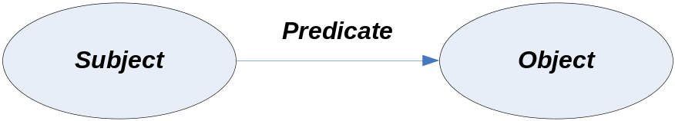
Introduction (IV)
RDF(S) Concepts (I)
Resources:
  Everything represented in RDF(S) is a resource
Instances and classes:
  Resources may be divided into groups called classes. The members of a class are known as instances of the class.
Graph-based data model:
  RDF Graph = Set of Triples
  Triple = <Subject, Predicate, Object>
URI-based vocabulary:
  URIs are used to identify the elements of the vocabulary
Notes:
Now I will briefly introduce some technical details of RDF.
In RDF everything is a resource. Resources can be divided into classes, that is groups of resources that have a common meaning. The members of the classes are known as instances
The underlying structure of any expression in RDF is a collection of triples, being a triple the union of a subject, a predicate and an object . This can be illustrated by a graph, in which the subject and predicate are nodes, and the links are the predicates. The direction of the link always points to the object.
The RDF(S) vocabularies are composed of elements identified by mean of URIs
A URI reference or literal used as a node identifies what that node represents.
A URI reference used as a predicate identifies a relationship between the things represented by the nodes it connects.

Slide 10
Introduction (V)
RDF(S) Concepts (II)
Datatypes:
  Used for representing values such as integers, floating point numbers and dates.
  Relies in XML Schema for the definition of new datatypes
Literals:
  Lexical representation of values such as integers, etc.
Facts:
  A fact indicates a relationship between two things.
  RDF triples are simple facts
  RDF graphs are complex facts made up of conjunctions of triples
Entailment:
  deduction: something that is inferred (deduced or entailed or implied);
Notes:
Datatypes are used by RDF in the representation of values such as numbers, strings and dates. RDF does not provide mechanisms for defining new datatypes, but is fully compatible with XML Schema datatypes.
Literals are used to identify values such as numbers and dates by means of a lexical representation.
Facts or assertions indicate relationships between two things. A simple fact may be represented as an RDF triple in which the predicate names the relationship, and the subject and object denote the two things. Thus, more complex fact are expressed in RDF using conjunctions (logical-AND) of simple binary relationships. RDF does not provide means to express negation (NOT) or disjunction (OR).
Entailment is related to the idea of inference. RDF has well defined semantics defined by means of a set of entailment rules, which allow inferring new information upon existing one.

Slide 11
RDF(S) Data Model Overview (I)
Overall organization
RDF(S
RDF(S
)
)
rdfs:Class
rdfs:Class
rdfs:member
rdfs:member
rdfs:seeAlso
rdfs:seeAlso
rdfs:isDefinedBy
rdfs:isDefinedBy
rdfs:value
rdfs:value
“
“
property
property
”
”
rdfs:label
rdfs:label
rdfs:comment
rdfs:Resource
rdfs:comment
rdf:first
rdfs:Resource
rdf:first
rdf:subject
rdf:subject
rdf:predicate
rdf:predicate
rdf:type
rdf:object
rdf:type
rdf:object
rdfs:subclassOf
rdf:rest
rdfs:subclassOf
rdf:rest
rdfs:subPropertyOf
rdfs:subPropertyOf
rdf:Statement
rdf:List
rdf:Statement
rdf:List
rdfs:Container
rdfs:Container
rdf:Property
rdf:Property
rdfs:Literal
rdfs:Class
rdfs:Literal
rdfs:Class
rdfs:domain
rdfs:domain
rdfs:range
rdfs:range
rdf:Bag
rdf:Bag
rdf:Seq
rdf:Seq
rdf:Alt
rdf:Alt
rdf:XMLLiteral
rdfs:Datatype
rdf:XMLLiteral
rdfs:ContainerMembershipProperty
rdfs:Datatype
rdfs:ContainerMembershipProperty
rdf:XMLLiteral
rdf:nil
rdf:XMLLiteral
rdf:nil
rdfs:member
rdfs:member
rdf
rdf
:_1
:_1
rdf
rdf
:_2
:_2
rdf
rdf
:_3
:_3
Notes:
This diagram shows the built-in RDF(S) vocabulary. The rectangles are classes and the links represent relationships between the classes. The name links represent specific built-in properties, whereas unnamed links represent subclass-of relationships.
As you can see the root class is Resource, and every other class is a subclass of it or of a “child” of it.
In the middle we can see the Class and Property classes which are, the main ones needed for building RDF(S) vocabularies. Both classes and properties can be organized in hierachies.

Slide 12
RDF(S) Data Model Overview (II)
Data model special features
No cardinality constraint in properties
Inference implicit
No close-world assumption:
  Partial model validation
  Key point for model aggregation
Notes:
There are some tricks and puzzles in the RDF(S) data model.
The first one is the absence of cardinality constraints in the properties. It is not possible to constraint the number of items involved in a relationship.
The second point is that inference is somehow implicit. As the domain and range of a property can be constrained, it can be possible to infer which is the type of a resource involved in a relationship. But this is not mandatory…
Another issue is the fact that the RDF(S) model doesn’t follow the close-world assumption: a graph just entails what it is, but doesn’t say anything about what it is not. We cannot assume that something doesn’t exist if there isn’t any assertion. We just don’t know it.
There are many other issues that I will not cover. Refer to the RDF(S) spec in case you want to check them.

Slide 13
Operational Model
Possible alternatives:
  Graph-oriented
  Object-oriented
Operation types:
  Creation/removal
  Retrieval
  Attachment/detachment
Side issues:
  Checked vs non-checked operations
  Inference aware vs inference unaware operations
Interface behaviour variable according these issues.
Notes:
Let’s move to the operational model of the access services. There are at least to possible ways for interacting with the model: following a graph-oriented set of operations or following an object-oriented one.
The graph-oriented operations would involve triple creation, retrieval and deletion. Simple, but not very usable. It doesn’t abstract the data model enough, as the user should have to know beforehand the built-in vocabulary to create, retrieve or delete the triples appropriately.
We have gone for a more object-oriented solution, trying to mimic the data model and providing the useful abstractions that enhance the usability of the final interfaces.
We have identified three sets of operations: creation/removal which deal with the management of instances; retrieval, those used for retrieving data; and attachment/detachment, those for managing the relationships between resources.
There are two key issues that we had to decide when we were beginning with the work:
- Should we have to provide validating operations, that is operations that check the validity of the model as it is being modified? For instance checking the domain and range constraints when creating a new relationship between to resources..
- The other one is related to how the inference mechanisms behave. Do we take into account the whole class hierarchy when retrieving the subclasses of a given class?
We want to provide a set of opperations whose behaviour can vary according the user needs, but giving also to the developer to decide which characteristics he want to develops. So all of these issues are optional, and should be configurable at runtime in those implementations that provide them.

Slide 14
Interface organization (I)
Organizational criteria
Two layers:
  Bulk access
  Specialized access
Interface types:
  Native interfaces: mimic classes of the RDF(S) data model
  Utility interfaces: provide additional functionalities that enhance usability
Message definition:
  Direct data access:
    Retrieval of directly associated information
    Creation of new data (including attachments)
    Deletion of existing data (including detachments)
  Indirect data access
    Delegation of access to services that provide specialized access to a subset of associated information
Notes:
Regarding the organization of the interfaces and operations, we have used the following criteria:
First we have splited in two layers the access mechanism, according to the granularity of the operations. There is a bulk layer in which we can create and delete instances and there is also a specialized layer where we manage the relationships between instances, and provide specific retrieval operations.
We have identified two types of services/interfaces, native ones which mimic the main classes of the RDF(S) data model and the utility services/interfaces. These ones are convenient abstractions that provide further functionalities that enhance the overall usability of the services.
Regarding to the operations themselves, we have left to direct data access those related to the retrieval, creation and deletion of data. Indirect data access has been used for moving from interfaces which provide coarse grained access to those that provide a specialized fine grained access.

Slide 15
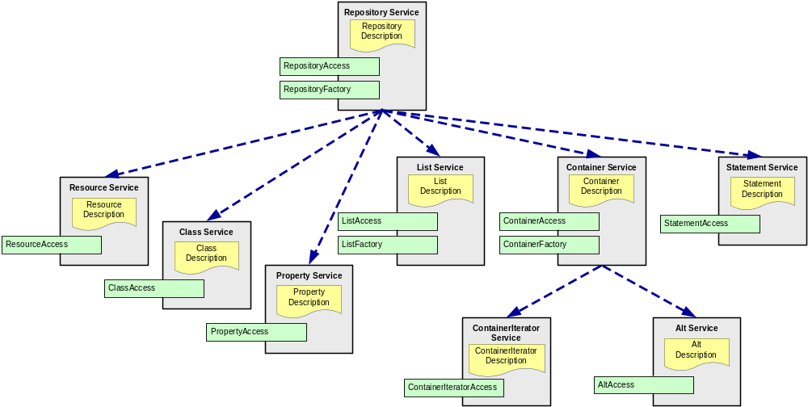

Interface organization (II)
Overall organization
Notes:
This picture shows which interfaces we have already identified and how they are organized.
We can see in green the native interfaces and in red the utility ones.

Slide 16
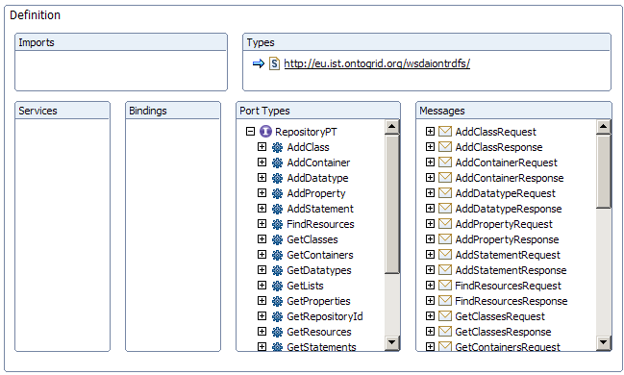
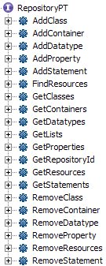
Interface specification (I)
Repository
Notes:
The RepositoryAccess interface is the frontend to the repository. It provides the basic functionalities for retrieving, creating and deleting contents to the repository, taking into account the specificities of the data element that is to be created, a class, a property, etc. This interface is, as you can imagine, part of the bulk layer.

Slide 17
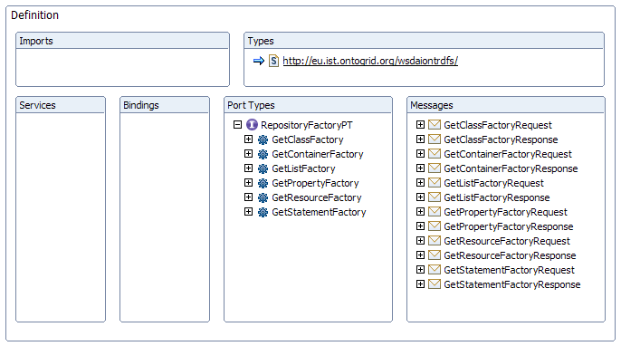
Interface specification (II) RepositoryFactory
Notes:
The RepositoryFactory is also in the bulk layer. It provides operations that allow the delegation of access to a specialized access interface, according to the nature of the element.

Slide 18
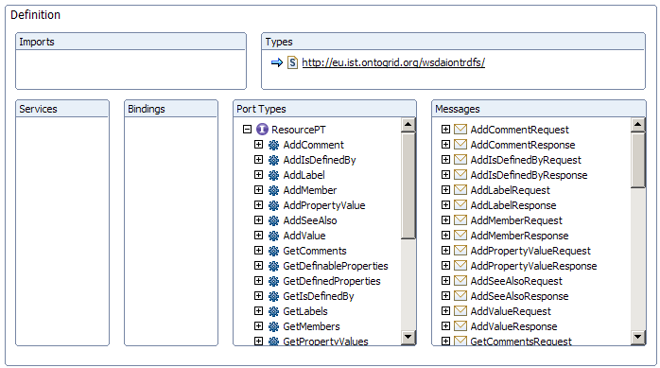
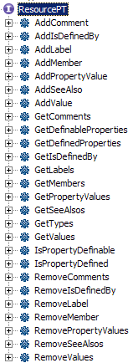
Interface specification (III)
Resource
Notes:
From now on, we will see interfaces that belong to the specialized layer.

Slide 19
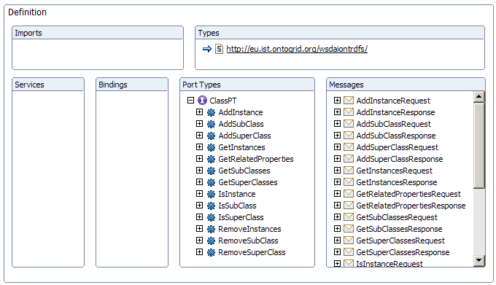
Interface specification (IV)
Class
Notes:
The ClassAccess interface provide methods for managing the class hierarchy, and for managing the instance of concrete class. Given a concrete class, we can add sub and super classes, find out which classes are sub or super classes and which are the instances of the class.

Slide 20
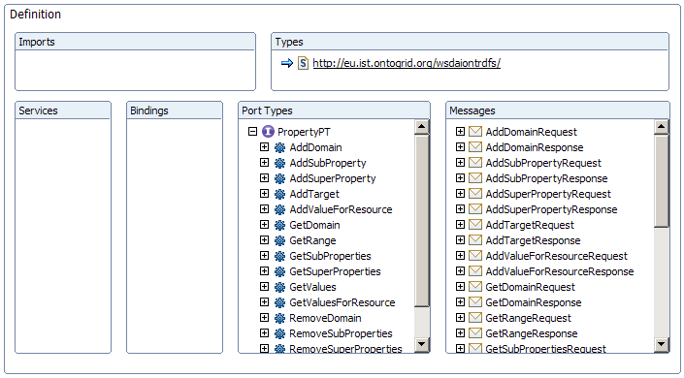
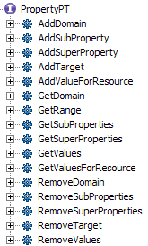
Interface specification (V)
Property
Notes:
The PropertyAccess interface provides operations for dealing with properties: constraining the domain and range, adding values for resources, retrieving and deleting those values.

Slide 21
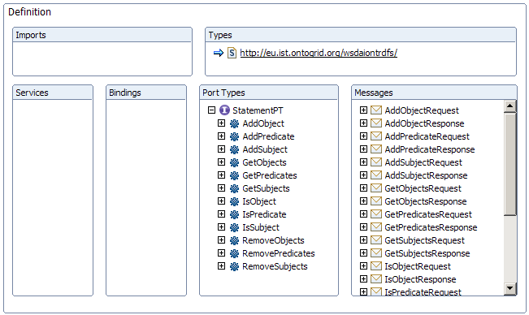
Interface specification (VI)
Statement
Notes:
The StatementAccess interface deals with reification information, it provides operations for specifying the subject, predicate and object of a Statement and for retrieving or removing them.

Slide 22
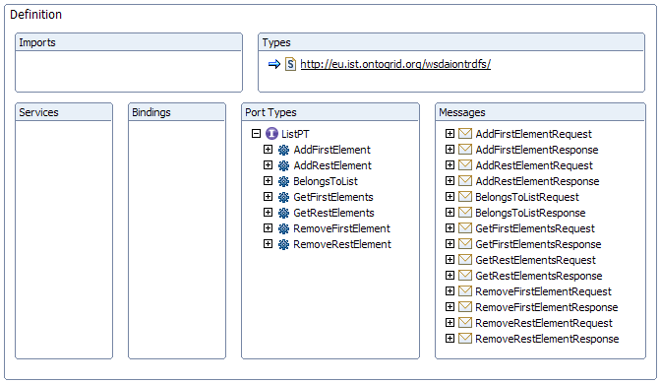
Interface specification (VII)
List
Notes:
The ListAccess interface provides operations for dealing with RDF lists: managing first and rest elements, mainly.

Slide 23
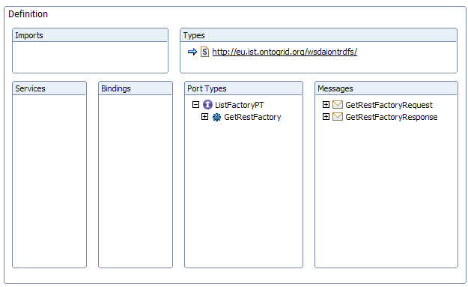
Interface specification (VIII)
ListFactory
Notes:
The ListFactory is provided for traversing the List.

Slide 24
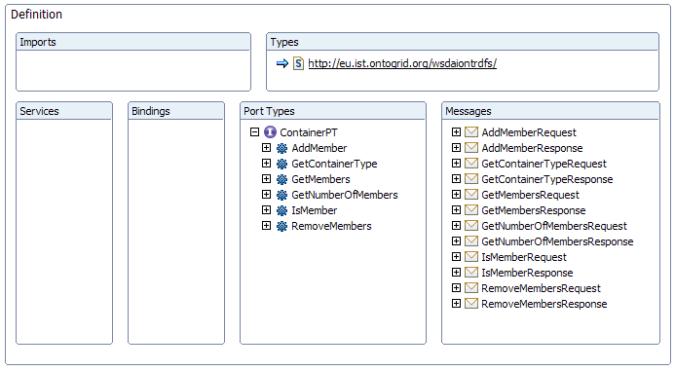
Interface specification (IX)
Container
Notes:
The ContainerAccess interface is provided for dealing with the RDF container abstraction, that is managing its members, accessing to them by means of its position.

Slide 25
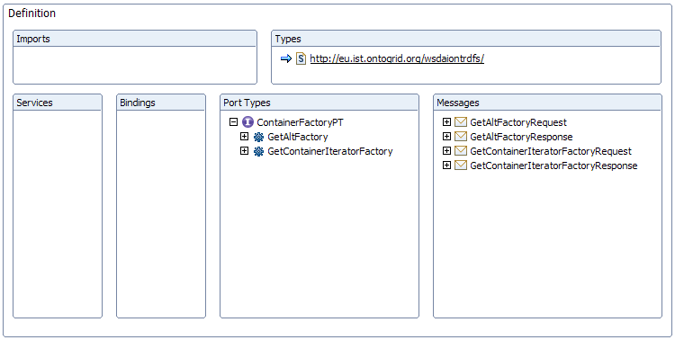
Interface specification (X)
ContainerFactory
Notes:
The ContainerFactory interface provides operations for delegating the access of the container to a specialized interface: and iterator interface or the alt interface.

Slide 26
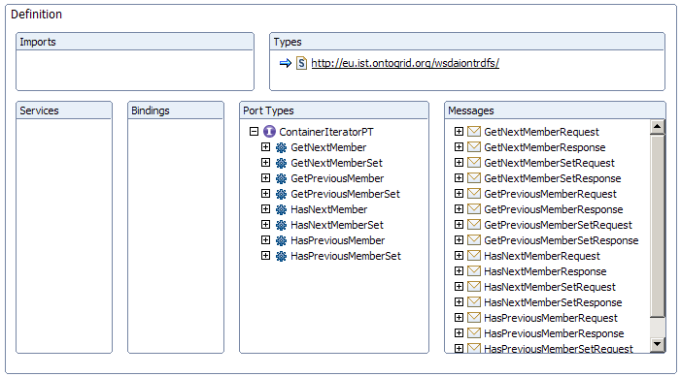
Interface specification (XI)
ContainerIterator
Notes:
The ContainerIteratorAccess interface is an utility abstraction provided for traversing a container without of caring about the exact position of the members.

Slide 27
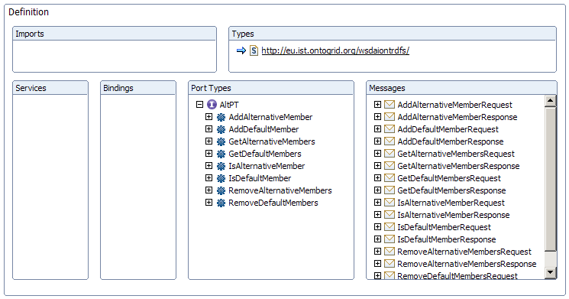
Interface specification (XII)
Alt
Notes:
Finally we have the AltAccess interface. The RDF class Alt is a type of Container which is a little bit different from the other built-in containers (Bag and Seq). The RDF Alt container separates the members in default and alternative ones. Therefore we have created an interface that provides specific operations for dealing with this issue.

Slide 28
Summary
Ontology-based access operations
Provided interfaces that,
  Mimic main classes of the data model, or
  Abstract useful functionalities that enhance usability
Followed object-oriented principles
Some figures:
  12 interfaces provided
  125 operations available
  18 faults defined
Notes:
Summaryzing, we have created a set of interfaces for accessing RDF that provide ontology-based operations for the task. We have provided interfaces that mimic the RDF(S) data model or abstract a useful set of functionalities that enhance the “user” experience…
All of this has been done following object orientation practices.
Some figures about the spec…

Slide 29
Future Work
Finish uncomplete operations
Behavioural aspects
  Static properties
  Configurable properties
Glossary of terms
Notes:
As future work, we have to finish some operations that are not fully defined. We also have to work in those behavioural aspects that I commented before. They are mostly related with the static and configurable properties of the interfaces. Finally, we are still to produce a joint glossary that will be used in the querying part and in the ontology one.

Slide 30

Thanks for your attention, questions?

